Slide 1
Module 5
Response
Develop the Plan
Format Plan
Write Plan
Review Plan
Approve and Share Plan
Step 5
Draft Plan
Learning Objectives
Determine and organize capabilities necessary to:
Save lives
Meet basic human needs
Protect property and the environment
Communicate with the public
Organize these capabilities in your active shooter plan
Recognition | Prevention | Protection | Mitigation | Response | Recovery
Planning Team | Assess Risk | Goals/Objectives | Develop Plan | Draft Plan | Implement
Notes:
Module 5 will cover Active Shooter Response. The two Learning Objectives are to help you identify 1) What are your capabilities to address saving lives, meeting basic human needs, and protecting property and the environment, and 2) How will you organize these capabilities in your plan? Think outside the box. Identify those capabilities are at the individual, organization, and community levels. How will your organization coordinate with responders?
In Step 5 of the planning process, we will cover Formatting, Writing, Reviewing, Approving, and Sharing an Active Shooter Plan.

Slide 2
Incident Response Times
1.5
min
2
min
3
min
6
min
Aurora Theater
Tucson Safeway
Columbine High School
Washington Navy Yard
60% of Active Shooter incidents end before the police arrive—FBI
Recognition | Prevention | Protection | Mitigation | Response | Recovery
Planning Team | Assess Risk | Goals/Objectives | Develop Plan | Draft Plan | Implement
Notes:
The active shooter incident happens in a very short period of time. The stakeholder must understand that 60% incidents are resolved prior to law enforcement arrival.
If your plan is to call 9-1-1 and wait for law enforcement to resolve the incident, this slide should illustrate the futility of that as an option.
Further these incidents illustrate that even incidents with very rapid law enforcement response times (from first 9-1-1 call to arrival on-scene of first officer) can have very high casualties.
The wounded value includes people hurt both by gunfire or in other ways during the shooting. In Aurora 70 total were injured (58 from gunfire; 12 were not struck with gunfire), according to the official after action report. In Tucson, a total of 14 were injured (one person did not sustain wounds from gunfire), according to the FBI criminal investigation of Jared Loughner. There were varying reports on the number wounded in the Navy Yard shooting—figures here are based on the FBI Active Shooter report.
Source: FBI Law Enforcement Bulletin, Active Shooter Events 2000 to 2013

Slide 3
Situational Awareness
Recognition | Prevention | Protection | Mitigation | Response | Recovery
Planning Team | Assess Risk | Goals/Objectives | Develop Plan | Draft Plan | Implement
Notes:
Chris Wood video (:52) speaking about the benefits of staying calm and communicating while being a hostage to a gunman.
Video produced by Kiernan Group Holdings, Inc., distributed courtesy the U.S. Department of Homeland Security.

Slide 4
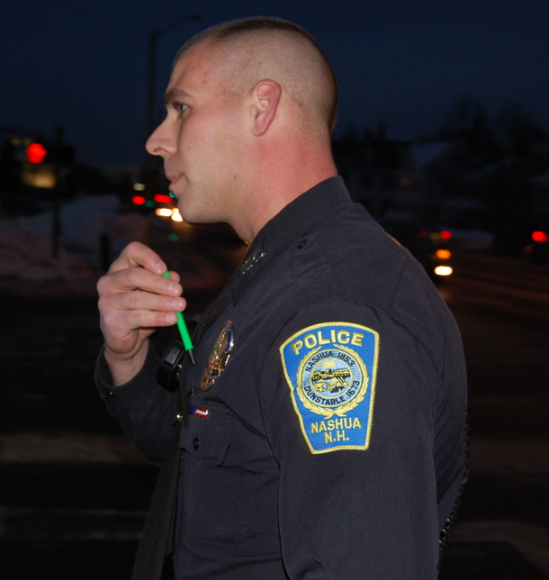
Law Enforcement Priorities
Protect Lives and Eliminate Threats
Manage the Incident
Participate in Unified Command
Secure Scene/ Conduct Investigation
Recognition | Prevention | Protection | Mitigation | Response | Recovery
Planning Team | Assess Risk | Goals/Objectives | Develop Plan | Draft Plan | Implement
Notes:
When first responders do arrive, there are several priorities that guide their actions. The primary goal is to eliminate the threat; other priorities, such as medical aid, may be initially delayed so they focus on preventing further injuries.
Picture Sources:
1. Image courtesy of Flickr user Edward Kimmel via https://www.flickr.com/photos/mdfriendofhillary/2184023838/in/photolist-4jZGcq-bpwydm-9HKe2D-c1bYLN-dWXLPa-6a58pQ-9qkQMw-c1c5c5-avzBJC-y3fA2-c8Lksq-sasHE6-diefMY-pWE8xZ-7XEZev-8i9w4J-e8MNdf-7JkWVW-aEYDth-9dRoR8-b85C5k-6Fcjqr-nLF25M-pVob4y-gHjyay-pZ32zB-4Nexi2-nnwaSp-nafp3U-pxLCM1-b5EmoK-b6owiT-7M6pHd-9qZpxj-pBz4Ti-4spSDT-qo5Rqy-qB9QKf-9oRNfg-6bEZG9-ei7pCY-pt8mTj-7Z4WFA-8RbF7m-nPLUcM-b6owUr-8PtKLS-9dddWi-dDs4jE-8e94co
2. Image courtesy of Wikimedia user sdlewis at https://commons.wikimedia.org/wiki/Category:Lenco_BearCat#/media/File:Nash_Bearcat.jpg

Slide 5
The First Minutes
Recognition | Prevention | Protection | Mitigation | Response | Recovery
Planning Team | Assess Risk | Goals/Objectives | Develop Plan | Draft Plan | Implement
Notes:
Video (2:06) The interviewees describe the first minutes of an active shooter incident.
Sergeant Baker is with the Howard County, MD police, referring to preparedness actions developed with the Columbia Mall prior to an active shooter incident.
Video produced by Kiernan Group Holdings, Inc., distributed courtesy the U.S. Department of Homeland Security.

Slide 6
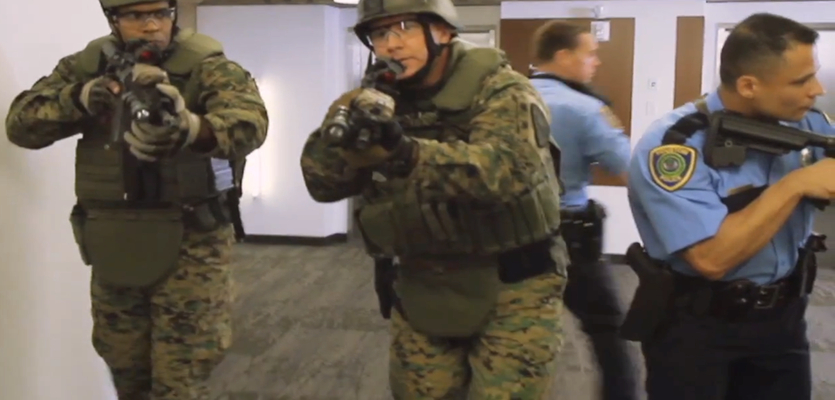
First Officers on the Scene
Their only job once on the scene is to go directly to the threat and eliminate it
Known as a Contact Team, FAST Team, and other designations; may be composed of multiple agencies
Recognition | Prevention | Protection | Mitigation | Response | Recovery
Planning Team | Assess Risk | Goals/Objectives | Develop Plan | Draft Plan | Implement
Notes:
First contact teams have one focus – getting to the location of the shooter(s) and taking them out.
While there are many acronyms and names for these teams, the concept is the same. Rural areas often have entry teams with only one or two officers, based on staffing and backup arrival.
This picture denotes that a team will often be comprised of officers from different agencies or patrol officers pairing with SWAT.
Pictures courtesy of George Washington University

Slide 7
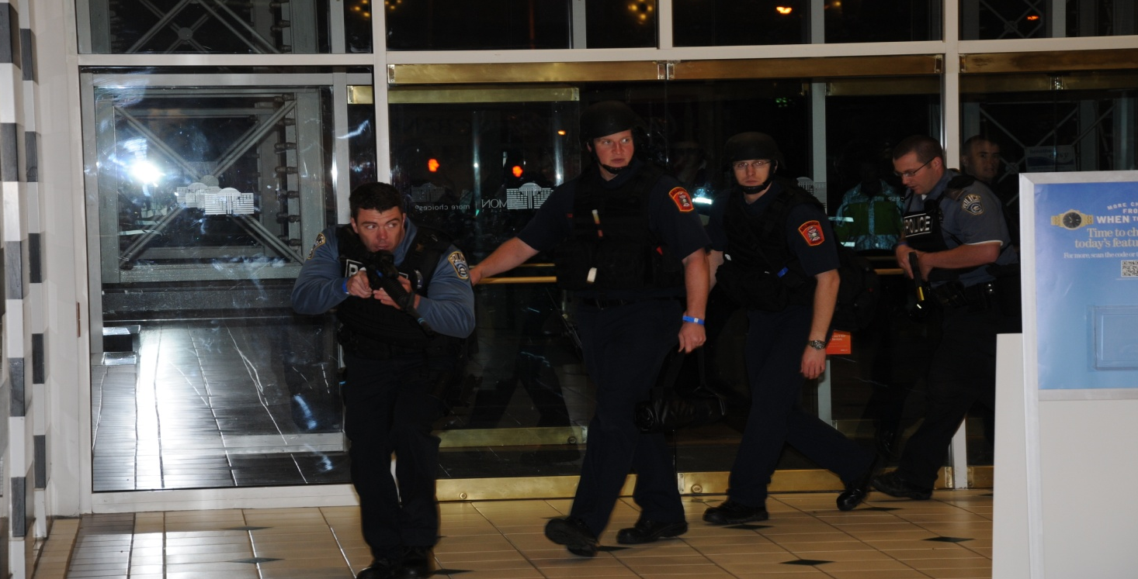
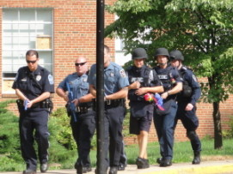
Integrated Rescue Task Force
Goal: Provide rapid point of wounding medical care and rapid extrication to definitive care using law enforcement and EMS
Four Primary Models
Escorted Warm Zone
Warm Corridor
Police Rescue
Cold/Protected Island
Recognition | Prevention | Protection | Mitigation | Response | Recovery
Planning Team | Assess Risk | Goals/Objectives | Develop Plan | Draft Plan | Implement
Notes:
New concept of integrating response entities to minimize time to delivery of life saving Tactical Emergency Casualty Care (TECC) interventions and other point of wounding care. All models have been put into practice by agencies/jurisdictions of varying sizes. Factors to be considered prior to implementation include: size of departments, available resources, response times, risk profile. The goal of all of these response models is to prevent deaths from potentially preventable causes that could occur if rescue/medical assets are waiting for the scene to be secured before initiating operations.
Escorted Warm Zone Model: Police and Fire/EMS form teams to enter the warm zone as soon as possible. LE function is solely force protection for rescue assets. Rescue assets must follow LE lead and understand movements and communication. Some agencies require ballistic PPE while others do not. Most rapid of the deployment models but requires highest level of inter-agency coordination. Important to emphasize these assets are NOT tactical LE or EMS teams.
Warm (protected) Corridor Model: takes more LE personnel and time to implement but carries less operational risk for medical personnel. In this model, LE officers take up tactical positions along a specified path creating inter-linked over watch. This corridor is then deemed clear, allowing rescue personnel to work freely (without direct escort) in the areas that have security set. Ballistic PPE is not typically used in this model.
Police Rescue Model: relies solely on LE personnel to respond to the threat, provide point of wounding care, and evacuate wounded to rescue personnel staged in a nearby clear area.
This model requires high numbers of LE personnel, recognition of LE personnel regarding the need to change operations from tactical to rescue, and proficiency/maintenance of medical skills.
This model carries the lowest risk for Fire/EMS as it is closest to the traditional safe staging model and requires the least amount of coordination between Police and Fire/EMS.
Cold/Protected Island model required LE to establish a secured/hardened casualty collection point and to escort medical personnel into that area. Injured persons are then moved by LE from the point of injury to that protected space for medical care.
This model requires high numbers of LE personnel, understanding of LE personnel on the requirements of a secure CCP, and recognition of LE personnel regarding the need to change operations from tactical to rescue.
As a whole, this model is closest to traditional triage/treatment areas with the collection point located inside an otherwise unsecured structure, and typically takes the longest to deploy.
Pictures courtesy of George Washington University

Slide 8
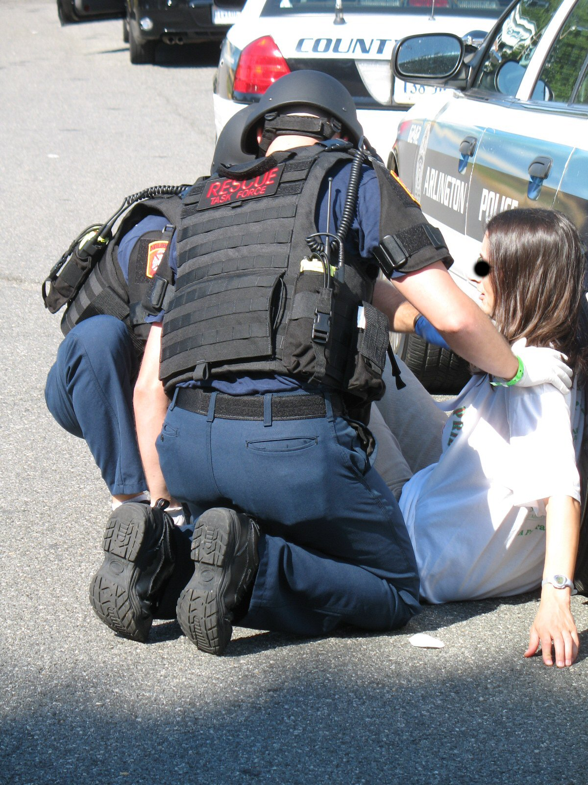
Tactical Emergency Casualty Care
Civilian Medical Guidelines for High Threat Situations
“Run”
Direct Threat/Hot Zone Care
Okay to move someone in harm’s way
Stop major bleeding with tourniquet
“Hide” and No Threat
Indirect Threat/Warm Zone Care
Stop all bleeding
Clear/Open the airway
Cover holes in the chest
Position and keep patient warm
Comfort and reassure the patient
Recognition | Prevention | Protection | Mitigation | Response | Recovery
Planning Team | Assess Risk | Goals/Objectives | Develop Plan | Draft Plan | Implement
Notes:
TECC was developed based on the successful military medicine model of Tactical Combat Casualty Care, but accounts for the differences in the civilian language, patient population (children, elderly, other special needs), baseline health, resources, and liability. The TECC guidelines describe the necessary interventions that can be appropriately scoped for use by any level of bystander (First Care Provider), law enforcement official, fire/EMS provider, or medical professional to minimize deaths from potentially preventable causes. TECC resources are free on-line and generic TECC training is available through multiple sources including FEMA grant funded courses.
When someone is faced with the decision of “Run, Hide, Fight” there are considerations that each person must make. If there is a Direct Threat (confrontation of the shooter, presence of an IED/explosive, or other imminent threat) you should Run from the threat if possible. Should there be a victim that is also in the Direct Threat area, that victim can be moved to safety if the “runner(s)” are capable and willing to initiate rescue. The risk of causing further injury by rapidly moving an injured person who remains in direct harm’s way is negligent when compared to the risk from the immediate threat. Although unlikely, the only medical intervention that should be considered, if time and equipment allows, is control of life-threatening external arm/leg bleeding through placement of a tourniquet as high on the injured extremity as possible over the clothes. Tourniquets are relatively safe when in place for limited amounts of time (less than two hours). Once a tourniquet is placed it should be left in place and not loosened until professional medical providers do so.
If a survivor is hiding during the event or if the event has ended but they are still with a patient until help arrives, they should consider providing Indirect Threat (IDT) care. IDT care includes stopping all bleeding using direct pressure, pressure bandages, and/or tourniquets which can be improvised or manufactured. Patients should be allowed and encouraged to position themselves in a way that is easiest to breathe and maintain a clear airway (not forced to lay down). Unconscious patients can be placed in the “Recovery Position,” and if necessary a jaw thrust or head-tilt chin-lift can be performed. Any potential open chest wound should be covered with an occlusive (plastic) dressing. All patients should be kept warm to help prevent shock. Comfort the patient and let them know that help is on the way.
Pictures courtesy of George Washington University

Slide 9
UC Santa Barbara: 5/23/14
Socially Isolated, Multiple Scenes
Shooter: Elliot Rodger, 22 y/o
Casualties: 6 killed, 13 wounded
Weapons: knife, handguns, vehicle
Outcome: Shooter committed suicide
Numerous prior indicators
Driving and shooting
Concern about multiple shooters
Recognition | Prevention | Protection | Mitigation | Response | Recovery
Planning Team | Assess Risk | Goals/Objectives | Develop Plan | Draft Plan | Implement
Notes:
One of the challenges to the responder community is to identify how many shooters. In the UC Santa Barbara (UCSB) incident, there were several separated crime scenes as the shooter drove from location to location. Were these simultaneous, coordinated attacks, or one shooter on the move?
With so many inconsistencies in citizen reports to 9-1-1, it can be very hard to discern.
On May 23 2014, Elliot Rodger stabbed three males to death in his apartment. He then drove to a sorority house where he knocked on the door aggressively but no one answered. He encountered a group and shot three women, two of them fatally, who were outside of the house. Rodger then drove to a deli mart, exited the vehicle, and fatally shot a man. Rodger continued driving and fired multiple rounds at two people on the sidewalk. He continued driving and shot at a Sheriff’s deputy who returned fire as Rodger continued driving. Rodger struck and injured a bicyclist, fired multiple shots at pedestrians, striking three, and shot another victim at an intersection. Rodger then encountered four Sheriff’s deputies, who exchanged fire with Rodger, striking him in the hip. Rodgers turned south, struck another bicyclist, and collided with parked cars. Responding officers removed Rodger from the car and discovered he was dead with an apparent gunshot wound to the head.
As you can see the challenge for first responders is the ability to determine if the casualties were from multiple shooters or one shooter moving and shooting at multiple scenes. Rodgers had been contacted by the sheriff’s department three times prior to the attack, was in contact with counselors and therapists from a young age, and wrote a manifesto describing his frustration against women, posting similar frustration in a YouTube video a week prior to his attack.
Picture Source:
Image courtesy of Wikimedia user Coolceasar via https://commons.wikimedia.org/wiki/File:Ucsbuniversitycenterandstorketower.jpg
Image courtesy of Flickr user Steve Rhodes via https://www.flickr.com/photos/ari/14110255318/in/photolist-nuSKj7-nMnotx-nuvrQo-ntejy5-nLZeD1-nt7Ubj-nLHier-nKYsuF-nuxvEJ-nuxn5L-nuxQ6D-nJXWQN-nw1Fdv-nwnGr1-nMbqd3-nNSd8i-nNwkTD-nNsHh7-nNLrjt-nNkNRq-nuu2Wc-nLsHcS-nP4mjz-nttY6b-nJWBEL-nwojwK-nQDiQn-nLZjx9-nKYFnV-ntMFu1-nuwXKw-nuwWKy-nuxJaR-nuxjwu-nuxvc9-nuxcze-nLYKod-nLRLMh-nLHdj6-nuvLW7-nKJYtd-nuu7Ka-nLRj7U-nJZaAA-ntrekM-nuvwWK-nw2jAz-nw3ojz-nNekKT-nw2kBx

Slide 10
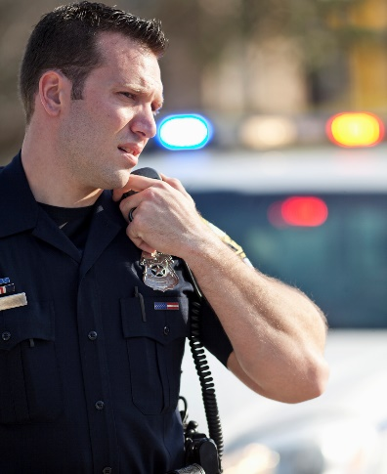
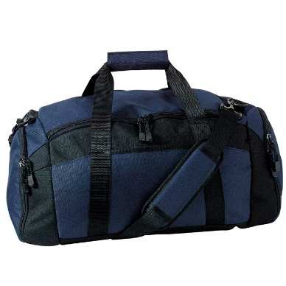
Responder Liaison
Designate someone to coordinate with emergency responders
Knowledgeable of the facility’s security procedures
Knowledgeable of the floor plans
Invite first responders to tour your facility
Ask for advice and recommendations
Prepare Go-Bags
Sample Go-Bag contents:
Maps w/ floor plans
Master keys
Controlled access swipe cards
Sharpies or large black grease pencils
Tourniquets/quick clot kits
Radios connected with site security
Flashlights
Recognition | Prevention | Protection | Mitigation | Response | Recovery
Planning Team | Assess Risk | Goals/Objectives | Develop Plan | Draft Plan | Implement
Notes:
Create a partnership by assigning a responder liaison to work with responders. Invite responders to your facility. Your active shooter plan must include a site assessment with all information you can provide to responders. This includes public address systems, security cameras, alarms, medical supplies, building maps, and primary and alternate ingress and egress routes and locations where your disabled, access and functional needs personnel may be sheltering in place. Identify a secondary staging area and coordinate that with both that organization location and first responders. What about personnel turnover? Temporary facility construction? In both cases, response planning is the responsibility of both the emergency responders and stakeholders to be familiar with facilities and current staffing and configuration.
Picture Source:
Image courtesy of Wikimedia user PeteSeeker via https://commons.wikimedia.org/wiki/File:Sport-Gear-Gym-Duffle-Bag-Navy.jpg
Image purchased from Getty Images

Slide 11
Coordinated Public Information
Incident
Post-Incident
Identify and train a spokesperson
Notice of resolution and facility status
Coordinate a public information message with stakeholders
Assistance notification and accountability
Disseminate information to employees and guests
Control rumors, community restoration
Recognition | Prevention | Protection | Mitigation | Response | Recovery
Planning Team | Assess Risk | Goals/Objectives | Develop Plan | Draft Plan | Implement
Notes:
A coordinated public information plan that can be divided into pre and post incident steps will help address stakeholders needs and inform the public in the event of an active shooter incident. What are considerations for your medical facility? Campus? Commercial office? Use of social media to inform the stakeholders, such as websites, Twitter, or Google alerts should be in place.
Appointing a spokesperson before an active shooter incident and a current active shooter plan ensures continued updates of appropriate information for community partners, visitors, first responders, and media. Having pre-authorized spokespersons, who can access pre-designated communications media during the incident with a cell phone or tablet can cover many of these information-sharing needs. Have the spokesperson meet with local Public Information Officers (PIOs) to learn their plan and procedures for coordination.

Slide 12
Media Report
Recognition | Prevention | Protection | Mitigation | Response | Recovery
Planning Team | Assess Risk | Goals/Objectives | Develop Plan | Draft Plan | Implement
Notes:
Media Report Video (2:13)
The CNN video of the Movie Theatre shooting in Aurora, Colorado is a media report we commonly see today. As you might expect, the first reports are seldom accurate but none the less can be extremely influential. Count in this short two-minute clip the number of detailed information quickly provided to the public.
Extended operations, continued media briefings, and coordination with the Incident Command post or jurisdictional authority are a significant part of the public information response.
Courtesy of CNN.

Slide 13
Media Response
Recognition | Prevention | Protection | Mitigation | Response | Recovery
Planning Team | Assess Risk | Goals/Objectives | Develop Plan | Draft Plan | Implement
Notes:
Video (5:10) Stories from survivors and journalist talking about the relationship between media and recovery.
Video produced by Kiernan Group Holdings, Inc., distributed courtesy the U.S. Department of Homeland Security.

Slide 14
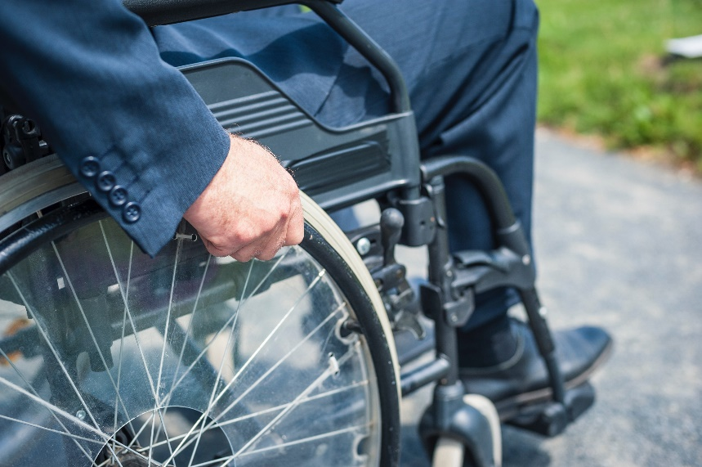
Disabilities and Access and Functional Needs
Active shooter planning practices recognize the power in setting the stage for successful “whole community” efforts
Be inclusive of people with disabilities, and/or with mobility, supervision, and communication accessibility requirements
Supervision
Communication
Mobility
Recognition | Prevention | Protection | Mitigation | Response | Recovery
Planning Team | Assess Risk | Goals/Objectives | Develop Plan | Draft Plan | Implement
Notes:
It is a legal requirement of the Americans with Disability Act to address facility challenges such as egress access, and to assist the needs of diverse populations. For active shooter incident response, this primarily includes notification issues, assistance for persons with mobility impairments and helping those who need assistance in implementing the appropriate protective actions. Include those with communication needs, such as deaf or hard of hearing populations, persons with Limited English Proficiency (LEP), as well as those with mobility challenges, and those who may need assistance in determining and implementing protective actions (children or adults with cognitive disabilities). For example, while children are not classified as disabled, they require the functional need of supervision by adults. This includes ensuring people are working with one another to plan and gain the knowledge to get out of harm’s way. Any person may “freeze” during a life threatening crisis. Train employees to assist others in evacuating or sheltering.
Actively involve and integrate individuals with disabilities and others with access and functional needs in the plan development and review.
Disability is a legally defined term for a protected class of individuals and remains an appropriate term.
When referring to “access and functional needs,” we are referring to people with and without disabilities who have physical, programmatic, and effective communication accessibility requirements. Meeting access and functional needs enables equal access to emergency programs for the whole community. The key access and functional needs issues associated with immediate notification and protective actions, are communication, supervision and mobility.
Language: Use people-first language; place the emphasis on the individual instead of the disability.
Use terms consistent with the integration mandate in the Americans with Disabilities Act which requires public agencies to provide services "in the most integrated setting appropriate to the needs of individuals with disabilities.”
Use language that is respectful and straightforward.
Refer to a person’s disability only if it is relevant.
Avoid terms that lead to exclusion (e.g., “special” is associated with “separate” and “segregated” plans and services).
Avoid terms that are judgmental, negative or sensational (e.g., special, brave, courageous, dumb, frail, super-human, vulnerable).
Avoid making assumptions or generalizations about the level of functioning of an individual based on their diagnosis or disability. Individuals are unique and have diverse abilities and characteristics.
Picture Source:
1. Image purchased from Getty Images

Slide 15
Inclusive Planning Considerations
Actively involve and integrate individuals with disabilities and those with access and functional needs in plan development and review
Buy-in at leadership levels is key to obtaining approval and dissemination
Programmatic – alternative formats
Printed information about what to do in the event of an active shooter
Multilingual information
Captioning
Physical access – ensure the facility is ADA compliant
Accessible evacuation routes
Ramps and access to secure hiding places
Post facility maps with labeled egress routes
Recognition | Prevention | Protection | Mitigation | Response | Recovery
Planning Team | Assess Risk | Goals/Objectives | Develop Plan | Draft Plan | Implement
Notes:
Roughly one in five Americans has a current disability. Planning and Implementation Resources for Disability and Access and Functional Needs Education may include:
National Council on Disability:
Emergency Management http://www.ncd.gov/policy/emergency_management
Effective Communications for People with Disabilities:
Before, During, and After Emergencies http://www.ncd.gov/publications/2014/05272014/
Community:
ADA National Network/FEMA Webinar Series: Emergency Management and Preparedness - Inclusion of Persons with Disabilities http://www.adaconferences.org/Emergency/Archives/
DOJ ADA Guide for Local Governments: Making Community Emergency Preparedness
And Response Programs Accessible to People with Disabilities
http://www.ada.gov/emergencyprep.htm
DHS Guide to Interacting with People Who Have Disabilities http://dhs.gov/sites/default/files/publications/guide-interacting-with-people-who-have-disabilties_09-26-13.pdf
Tips for effectively communicating with protected populations during response and recovery http://www.dhs.gov/publication/tips-effectively-communicating-protected-populations-during-response-and-recovery
FEMA Office of Disability Integration and Coordination http://www.fema.gov/office-disability-integration-and-coordination
IS-368: Including People With Disabilities & Others With Access & Functional Needs in Disaster Operations https://training.fema.gov/EMIWeb/IS/courseOverview.aspx?code=IS-368
Are You Ready? https://www.ready.gov

Slide 16
Step 5 in the Planning Process
STEP 1:
Form Planning Team
STEP 2:
Conduct Risk Assessment
STEP 3:
Establish Goals and Objectives
STEP 4:
Assess Courses of Action
STEP 5:
Draft Plan & Approve
STEP 6: Training and Exercise
Step 1: Form Planning Team | Step 2: Conduct Risk Assessment | Step 3 Establish Goals and Objectives | Step 4: Assess Courses of Action | Step 5: Draft Plan and Approve | Step 6: Training and Exercise
Identify Core Planning Team Form a Common Framework Define and Assign Roles Determine a Meeting Schedule | Identify Threats and Hazards Assess Risk Prioritize Risk and Hazards | Develop Goals Develop Objectives | Identify Courses of Action Identify Resources Assign COAs to Positions | Format the Plan Write the Plan Review the Plan Approve and Share the Plan | Train Stakeholders Exercise the Plan Review, Revise and Maintain the Plan
Recognition | Prevention | Protection | Mitigation | Response | Recovery
Planning Team | Assess Risk | Goals/Objectives | Develop Plan | Draft Plan | Implement
Notes:
Step 5 of 6 in the planning process includes deciding on a format as well as writing and reviewing the plan. The plan approval is usually completed by the senior leadership of the organization.

Slide 17
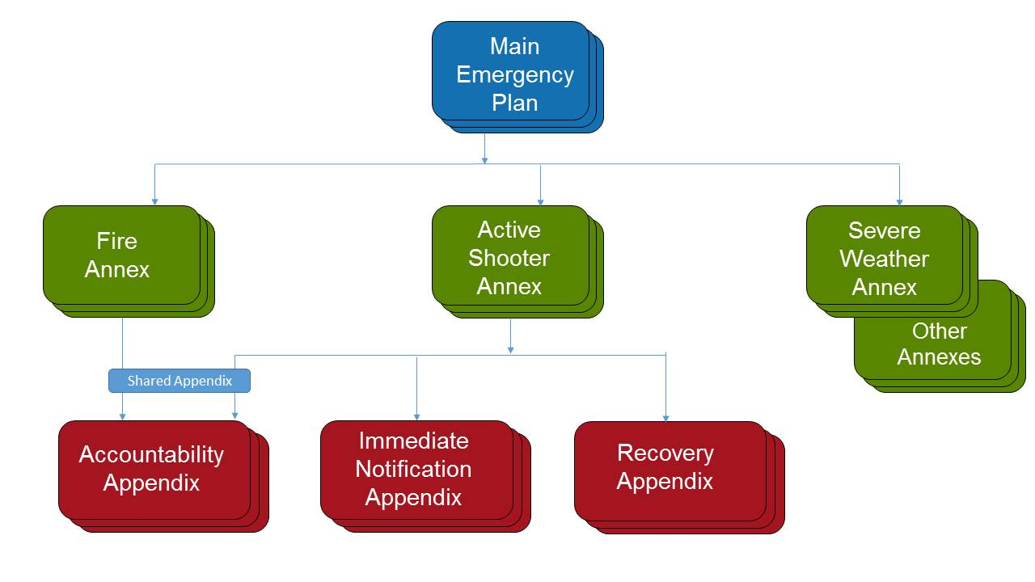
Plan Structure
Recognition | Prevention | Protection | Mitigation | Response | Recovery
Planning Team | Assess Risk | Goals/Objectives | Develop Plan | Draft Plan | Implement
Notes:
Most organizations have a main emergency plan with annexes that cover additional hazards. This is a typical plan hierarchy diagram showing this concept. As the plans are built out the annexes may contain further breakout details in the appendices. Some appendices are only used by a single annex, while other appendices can be “shared” by more than one annex. Usually this is done by an annex referencing an appendix for specific procedures or details.

Slide 18
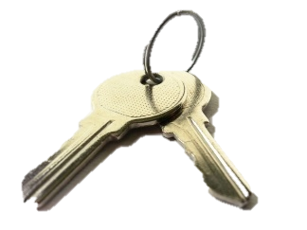
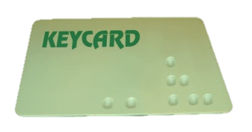
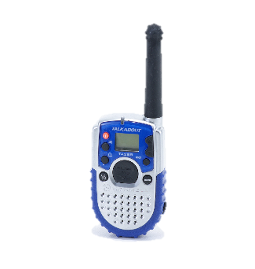
Preparation and Planning Actions
Develop a notification system
Identify evacuation routes and shelter locations
Plan for persons with disabilities
Account for personnel and guests
Coordinate preparation with existing plans
Train employees to recognize and report concerns
Provide a “go-bag” for use by arriving responders
Recognition | Prevention | Protection | Mitigation | Response | Recovery
Planning Team | Assess Risk | Goals/Objectives | Develop Plan | Draft Plan | Implement
Notes:
This slide contains common examples of preparation and planning actions. What are specific preparations necessary for your organization? What gaps do you need assistance in resolving? What internal and external stakeholders can help with your planning actions?
Keys – Image courtesy of PublicDomainPictures.net user Charles Rondeau via http://www.publicdomainpictures.net/view-image.php?image=41545&
Keycard – Image courtesy of Wikimedia user Baran Ivo via https://commons.wikimedia.org/wiki/File:Keycard2.jpg
Walkie Talkie – Image courtesy of Wikimedia user Aaronwarduk via https://commons.wikimedia.org/wiki/File:MOT-TA-288.png

Slide 19
Module 5 Planning Activity
Describe your proposed plan format
Describe how you will address persons with disabilities
What are the steps in your plan approval process?
How will you distribute your plan?
Recognition | Prevention | Protection | Mitigation | Response | Recovery
Planning Team | Assess Risk | Goals/Objectives | Develop Plan | Draft Plan | Implement
Notes:
Plan format can be the same as your existing emergency plans or refer to the Comprehensive Planning Guide 101 for alternative plan formats. The CPG 101 Annex has a good example to help you.

Slide 20
Break
Notes:
Image found on Youtube courtesy of Youtube user EnjoyDisfruta via https://www.youtube.com/watch?v=N9o4MoJVoa4

